Slide 1
Birch: Balanced Iterative Reducing and clustering using hierarchies

Slide 2
Birch’s goals:
Ability to do what was done in the previous steps
Minimize running time and data scans, thus formulating the problem for large databases
Clustering decisions made without scanning the whole data
Exploit the non uniformity of data – treat dense areas as one, and remove outliers (noise)

Slide 3
Clustering Features (CF)
CF is a compact storage for data on points in a cluster
Has enough information to calculate the intra-cluster distances
Additivity theorem allows us to merge sub-clusters

Slide 4
Clustering Feature (CF)
Given N d-dimensional data points in a cluster: {Xi} where i = 1, 2, …, N,
CF = (N, LS, SS)
N is the number of data points in the cluster,
LS is the linear sum of the N data points,
SS is the square sum of the N data points.

Slide 5
CF Additivity Theorem
If CF1 = (N1, LS1, SS1), and
CF2 = (N2 ,LS2, SS2) are the CF entries of two disjoint sub-clusters.
The CF entry of the sub-cluster formed by merging the two disjoin sub-clusters is:
CF1 + CF2 = (N1 + N2 , LS1 + LS2, SS1 + SS2)

Slide 6
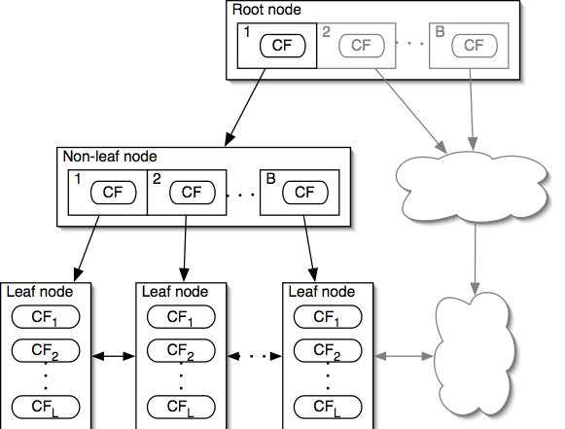
Properties of CF-Tree
Each non-leaf node has at most B entries
Each leaf node has at most L CF entries which each satisfy threshold T
Node size is determined by dimensionality of data space and input parameter P (page size)
Notes:
A non-leaf node entry is a CF tuple and a child node link
A leaf node is a collection of CF tuples and links to the next and previous leaf nodes
T is maximum diameter (or radius) of any CF in a leaf node
CFs "absorb" data points close to them
BALANCED HEIGHT!

Slide 7
CF Tree Insertion
Identifying the appropriate leaf: recursively descending the CF tree and choosing the closest child node according to a chosen distance metric
Modifying the leaf: test whether the leaf can absorb the node without violating the threshold. If there is no room, split the node
Modifying the path: update CF information up the path.

Slide 8
Birch Clustering Algorithm
Phase 1: Scan all data and build an initial in-memory CF tree.
Phase 2: condense into desirable length by building a smaller CF tree.
Phase 3: Global clustering
Phase 4: Cluster refining – this is optional, and requires more passes over the data to refine the results

Slide 9
Birch – Phase 1
Start with initial threshold and insert points into the tree
If run out of memory, increase thresholdvalue, and rebuild a smaller tree by reinserting values from older tree and then other values
Good initial threshold is important but hard to figure out
Outlier removal – when rebuilding tree remove outliers

Slide 10
Birch - Phase 2
Optional
Phase 3 sometime have minimum size which performs well, so phase 2 prepares the tree for phase 3.
Removes outliers, and grouping clusters.

Slide 11
Birch – Phase 3
Problems after phase 1:
  Input order affects results
  Splitting triggered by node size
Phase 3:
  cluster all leaf nodes on the CF values according to an existing algorithm
  Algorithm used here: agglomerative hierarchical clustering

Slide 12
Birch – Phase 4
Optional
Do additional passes over the dataset & reassign data points to the closest centroid from phase 3
Recalculating the centroids and redistributing the items.
Always converges (no matter how many time phase 4 is repeated)

Slide 13
Example of BIRCH
New subcluster
sc8
sc3
sc1
sc4
sc5
sc6
sc7
sc2
LN2
LN3
Root
LN1
LN1
LN2
LN3
sc8
sc1
sc3
sc5
sc6
sc7
sc2
sc4

Slide 14
Insertion Operation in BIRCH
If the branching factor of a leaf node can not exceed 3, then LN1 is split.
sc8
sc3
sc1
sc4
sc5
sc6
sc7
sc2
LN1’
LN2
LN3
LN1”
Root
LN1’
LN2
LN3
LN1”
sc8
sc1
sc3
sc5
sc6
sc7
sc2
sc4

Slide 15
If the branching factor of a non-leaf node can not exceed 3, then the root is split and the height of the CF Tree increases by one.
sc8
sc3
sc1
sc4
sc5
sc6
sc7
sc2
LN1’
LN2
LN3
LN1”
Root
NLN1
NLN2
LN1’
LN2
LN3
LN1”
sc8
sc1
sc2
sc3
sc5
sc6
sc7
sc4

